Slide 1




Critical Design Review
Smells Like Particulate Matter
Palmetto Scholars Academy
Team 1
Notes:
Michael: Hello we are Palmetto Scholars Academy Team 1 and this is our Pre-CDR

Slide 2
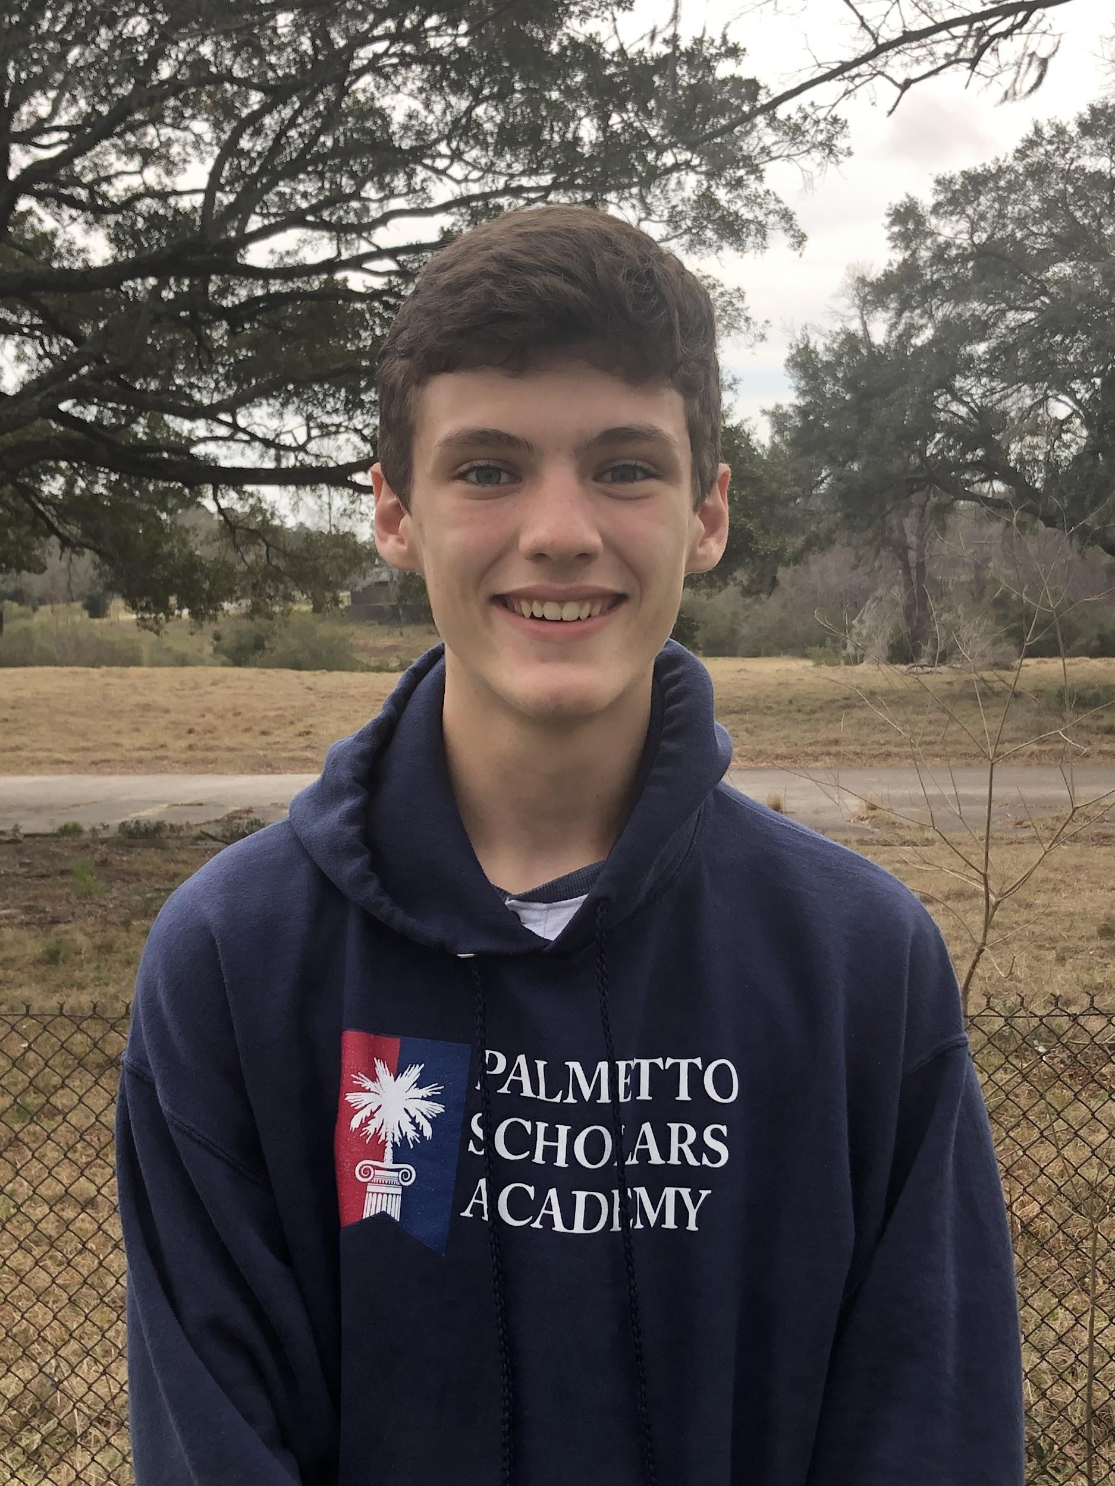
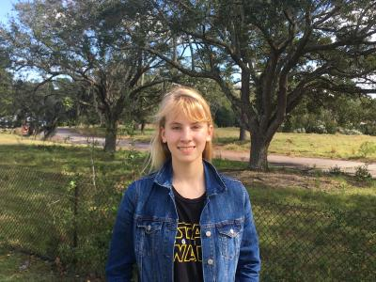
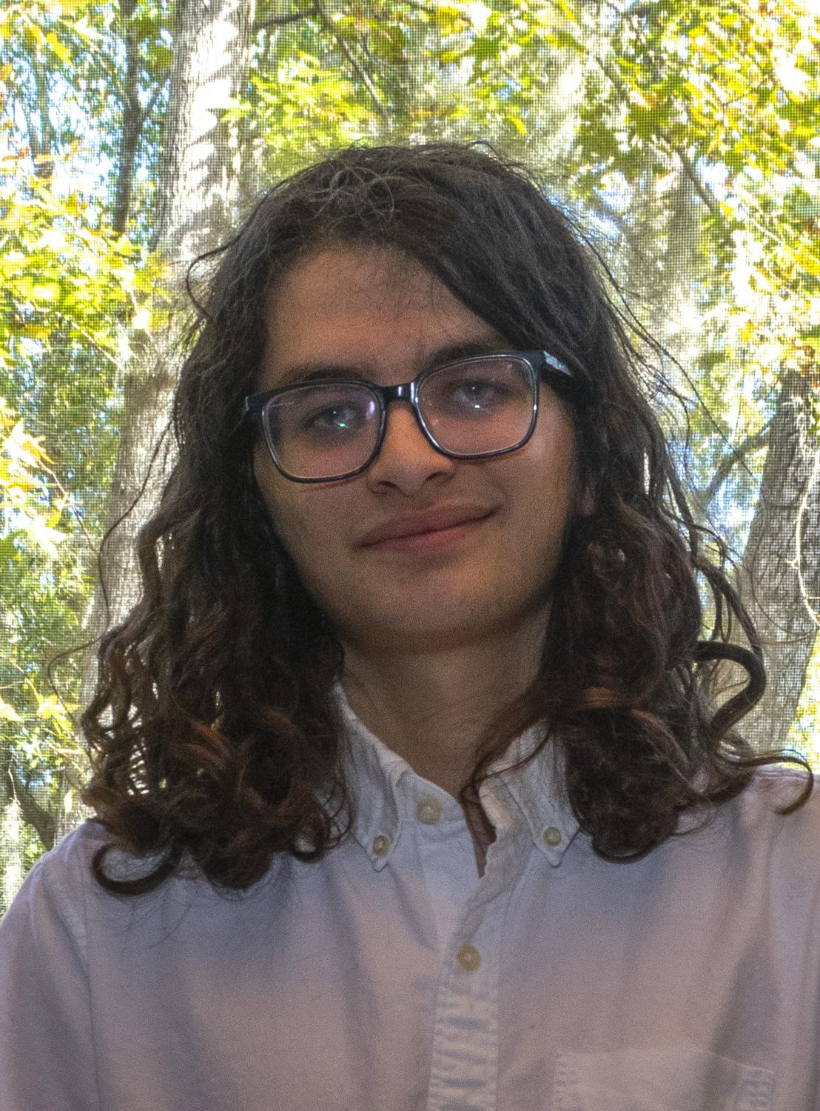
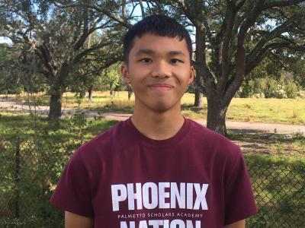
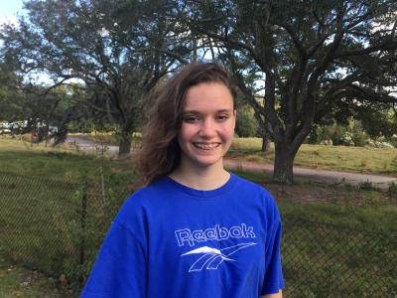
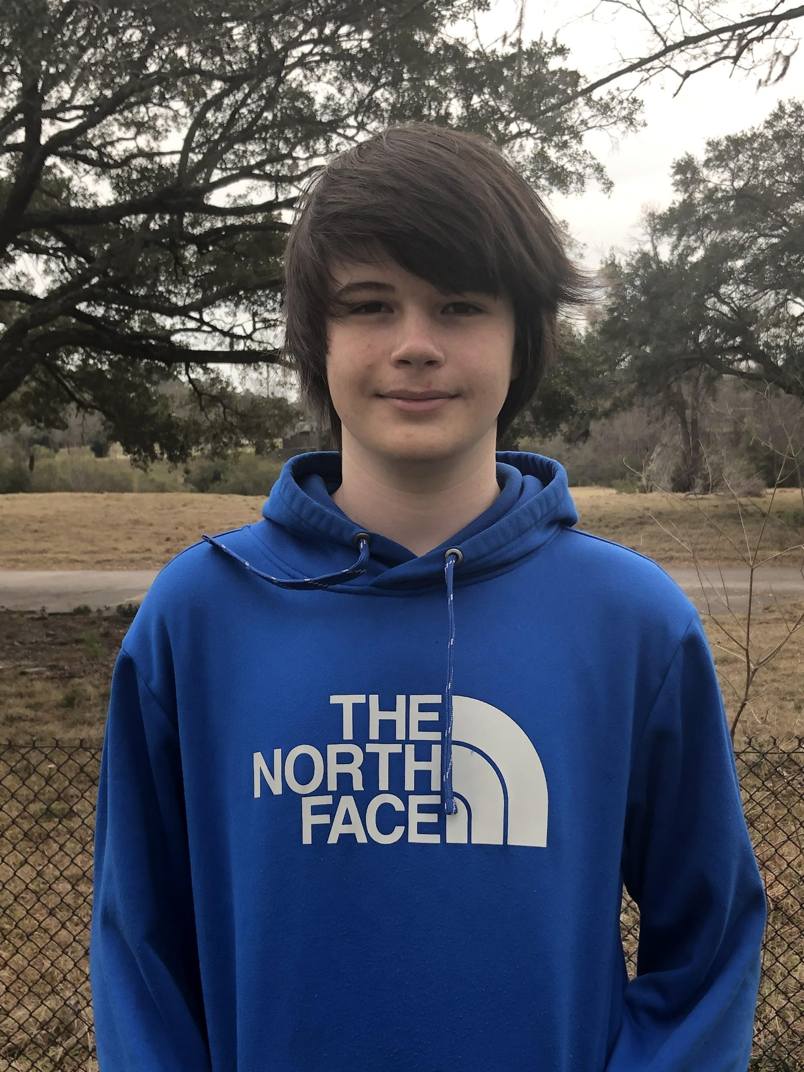
Team Lead
Michael
Blunt
11th Grade
Programming Lead
Max
Freedman
11th Grade
Test Lead
Emann
Rivero
12th Grade
Chief Engineer
Samantha
Quartuccio
12th Grade
Programming Group
Benjamin
Deaton
11th Grade
Test Group/Outreach
Morgan
Peterson
11th Grade
Notes:
Name, role, grade
Michael → Sam → Max → Emann → MORGAN → BEN

Slide 3

Smells Like Particulate Matter
“[Our] goal is simple. It is a complete understanding of the universe, why is it as it is and why it exists at all” - Stephen Hawking
Notes:
Morgan
This year our team is based around the band NIRVANA. Our team name is SMELLS LIKE PARTICULATE MATTER which is an alteration of the famous song by NIRVANA called SMELLS LIKE TEEN SPIRIT. We chose this as our science objective surrounds the study of particulate matter. Our logo takes inspiration from the Smells like teen spirit cover, we simply replaced the title, and altered the background and center photo. Our slogan is a quote by Stephen Hawking [read quote] , and it was chosen to represent the vastness of opportunities of what we can chose to build our objective around in the competition. We also thought it funny as it alludes to the sometimes way out of the box and ambitious ideas we come up with as a team when coming up with when brainstorming. NEXT SLIDE PLEASE

Slide 4
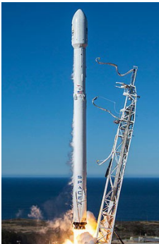
ACES RED 2B
Studying quantum entanglement for space satellite communications.
Sponsored by U.S. Space and Missile Defense Command (SMDC)
Secondarily investigating the use of low-cost commercial-off-the-shelf (COTS) hardware
To replace currently used expensive equipment
Primary objective of DETECTS
Notes:
Ben - Aces Red 2B will be studying quantum entanglement for space satellite communications, while being sponsored by the US Space and Missile Defense Command. It will also have the secondary project of investigating the use of low cost commercial off the shelf hardware in order to find replacements for currently used expensive equipment. This is also the primary objective of the DETECTS program. Next Slide please.

Slide 5
Design Requirements
Mechanical/Spatial Requirements | Electrical Requirements
Must be no larger than 65x56.5mm Must be less than 19mm above the surface of the Pi when plugged in | NO High-voltage-inducing instruments (over 28 V) Pinout used must be the one found on the Pi Pins 30 and 31 cannot be used
Material Requirements | Software Requirements
NO Mechanisms or moving parts NO Liquids, gases, or fluids of any kind NO Organic material or any other exotic material NO Vibrating/oscillating components NO Loose/powdered material NO Batteries or electrolytic capacitors | Must be developed on a Raspberry Pi 3B+ Must operate the Pi HAT and gather data from it Data rate must NOT exceed 5 kilobytes per second Must communicate with the AR2B flight computer via JSON formatted packets Transfer JSON packets into a folder called /tmp/experiment/ in the Raspberry Pi’s file system Must include an identifier within the JSON packet
Notes:
Michael: The Detects Requirements are broken into four different categories. To meet the mechanical/spatial requirements, our PI hat must be no larger than 65 by 56.5 millimeters, and no taller than 19mm. The electrical requirements detail that we cannot modify the original PI pinout, and we must reserve pins 30 and 31. Our material requirements require us to have no moving parts, liquids, gasses, powders, and generally prohibit anything that could cause harm to AR2B. Finally our software requirements require us to be able to operate and send data to the AR2B flight computer at no more than 5 kilobytes per second. Next Slide Please.

Slide 6
Science Objectives
Notes:
Max: Here are our science objectives

Slide 7
Potential Science Objectives
Material reflectivity in an enclosed space
What: Measure innate reflectivity of specific materials in a 0 lux environment
How: Reflectance sensor, outputs voltage (% reflectance)
Why: Ensure consumer devices that utilize reflectance can have full usability
Commercial-Grade Contaminants Comparison
What: Assess particulate matter from AR2B using consumer sensors; compare to AR2B data
How: Sensirion Particulate Sensor 30, outputs µg/m3
Why: Tests usability of consumer grade sensors in space missions; AR2B secondary objective
Fiber Optic cabling radiation
What: Study the effects of background radiation on fiber optics
How: Voltage output pin through fiber optics, ADC to measure voltage loss
Why: Assesses any spatial effects on fiber optic cabling
Notes:
Max
These are our potential science objectives.
Our first potential science objective is entitled material reflectivity in an enclosed space. With this science objective we would measure reflectivity of specific materials with a reflectance sensor within the near 0 lux environment of the AR2B tray. Many consumer technology devices, such as screens, use reflectivity to function.
With our second science objective, “Commercial-Grade Contaminants Comparison” we would be studying and assessing the particulate matter outgassed from AR2B utilizing a particulate matter sensor. This would help figure out the real difference between consumer and commercial/military grade sensors.
Our third and final potential science objective, “Fiber Optic cabling radiation”, would look at and study the effects of background radiation on fiber optic cabling by utilizing a simple voltage output and input to measure any losses. This is key to figuring out to what effect spatial radiation has on connectivity with fiber optics.

Slide 8
Science Objective Trade Study
FOM | Weight | Material Reflectivity |  | ACES RED 2B Contaminants Comparison |  | Fiber Optic Radioactivity
 |  | Raw | Weighted | Raw | Weighted | Raw | Weighted
Interest of Team | 9 | 3 | 27 | 3 | 27 | 9 | 81
Measurement Method | 9 | 9 | 81 | 9 | 81 | 3 | 27
Likelihood of success | 9 | 3 | 27 | 9 | 81 | 3 | 27
Sensor Complexity | 3 | 3 | 9 | 9 | 27 | 3 | 9
Sensor Resolution | 3 | 3 | 9 | 9 | 27 | 3 | 9
Scientific Ramifications | 1 | 1 | 1 | 9 | 9 | 9 | 9
Justifiability | 9 | 1 | 9 | 9 | 81 | 3 | 27
Public Comprehension | 1 | 3 | 3 | 3 | 3 | 1 | 1
Public Interest | 1 | 3 | 3 | 1 | 1 | 1 | 1
TOTAL |  |  | 169 |  | 337 |  | 191
Notes:
Sam
In our science objectives trade study, the figures of merit or FOMs assigned to us by UAH were Interest of Team, Measurement Method, Likelihood of Success, Sensor Complexity, Sensor Resolution, Scientific Ramification, and three of our own: Justifiability, Public Interest and Public Comprehension, each given a weight of either 1, 3 or 9. The Science Objectives were then given a score for each FOM, either 1,3, or 9, and then multiplied by the weight to give a final score. Contaminants Comparison was selected as our chosen science objective due to its high scores in Measurement Method, Likelihood of Success, and Interest of Team, FOMs that our team considered very important to a successful payload.
*add notes into explaining the three bolded foms*

Slide 9
Chosen Science Objective
Commercial-Grade Contaminants Comparison
Establish an experiment that can compare the quality and quantity of data accumulated from commercial-grade and professional-grade equipment
Assess particulate density, prevalence, size, and levels over time from ACES RED 2B using consumer-grade sensors
Notes:
Michael
Our chosen science objective, Commercial-grade Contaminant Analysis Comparison will compare the quality and quantity of data accumulated from our Raspberry Pi and ACES RED 2B equipment. This objective complies with the ACES Red 2B mission nicely, as a secondary objective of ACES Red 2B is investigating the use of low-cost commercial-off-the-shelf (COTS) hardware to potentially replace or supplement expensive, professional-grade hardware currently used on space satellites. We are looking to assess particulate matter inside ACES RED 2B using consumer sensors, and we wish to compare our data with the testing data generated by ACES Red 2B and previous data generated by AR2A.

Slide 10
Hypothesis
What is the difference in both quality and quantity of measurement between consumer grade and military grade sensing technology?
We believe that the inaccuracy of data provided by the consumer grade sensing technology will be not be impressive enough to warrant the costs typically associated with these instruments.
Notes:
Michael
Our research question is: What is the difference in both quality and quantity of measurement between consumer grade and military grade sensing technology?
From that: We believe that the inaccuracy of data provided by the consumer grade sensing technology will be not be impressive enough to warrant the costs typically associated with these instruments.
Consumer grade sensors have come a long way since the advent of these technologies, and the price gap simply does not warrant the benefits gained from these technologies.
If these sensors are shown to be accurate enough to not cause concern, they may replace sensors with similar purposes that can cost exorbitant amounts of money.

Slide 11
Science Traceability Matrix
Science Objective | Measurement Objective | Measurement Requirement | Instrument Selected
Commercial-Grade Contaminants Comparison | Measure Particulate density, prevalence, size, and levels over time. | Be able to collect particulate data from ACES RED 2B. | SPS30
Notes:
Ben -
Here is our science Traceability Matrix, we will be focusing on Commercial-Grade Contaminants Comparison. Our measurement objectives include measuring particulate density, prevalence, size, and levels over time. To fulfill these objectives we will be using an SPS30, a consumer grade gas and particulate sensor. Next Slide Please

Slide 12
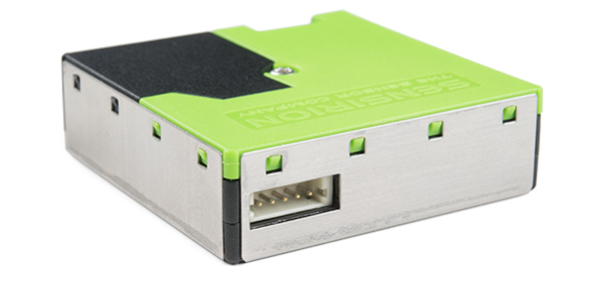
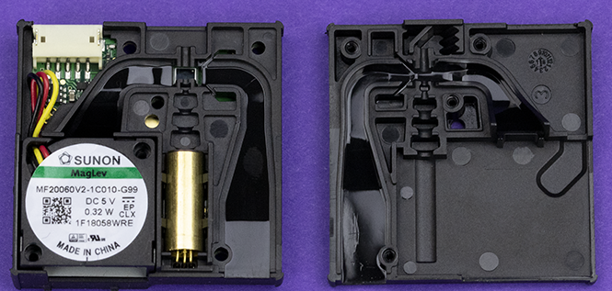
Particulate Sensor - SPS30
This particulate sensor is one of the smallest and most accurate consumer grade sensors on the market today.
dimensions: 40mm * 40mm * 12mm
min detectable: 0.3μm diameter
output: digital (I²C)
accuracy: ±10 μm/m³
long-term drift: ±1.25 (μm/m3)/year
Notes:
Ben - Our Particulate matter sensor, the SPS30, is one of the better consumer grade particulate matter sensors on the market today. It features a compact design with incredible accuracy and sensitivity, as well as low long term drift and a Pi compatible digital output. Next Slide Please

Slide 13
Experiment Design
Notes:
Ben

Slide 14
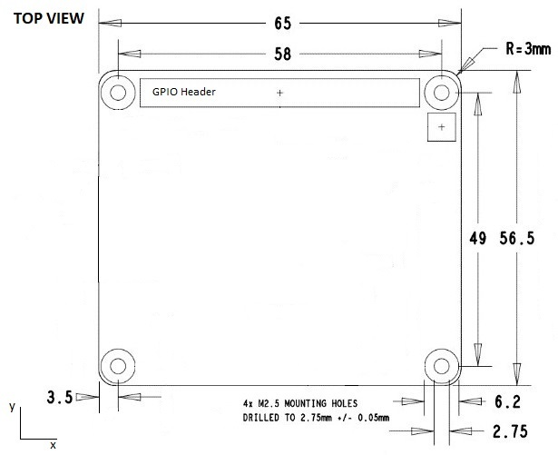
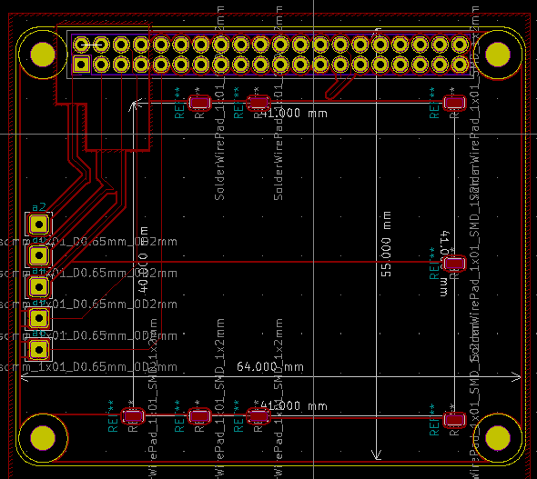
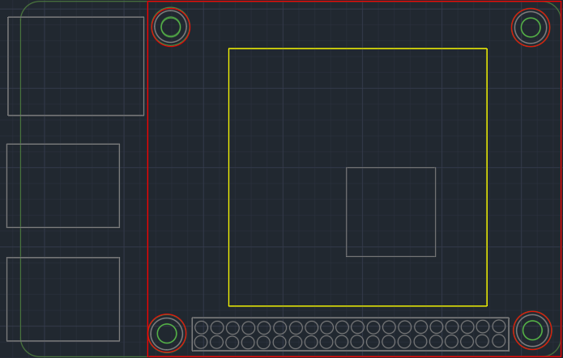
Experiment Configuration
Current HAT Design
40.6mm * 40.6mm SPS30 - Yellow
Onboard NIC
For Reference
GPIO Header - All 40 Pins have been raised 5mm
Notes:
Sam
This is an overall view of our experiment configuration, showing the length and width of our pi hat at 65 x 56.5mm, the length and width of our particulate matter sensor at 40.6mm by 40.6mm, and our current HAT design.

Slide 15
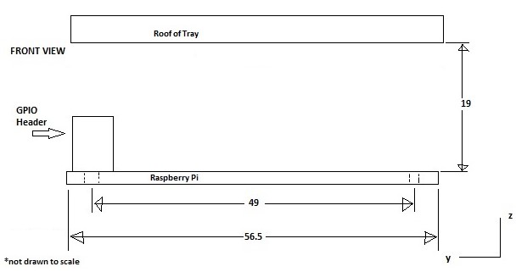
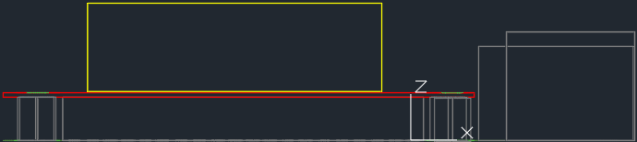
Experiment Configuration (cont.)
12.2mm SPS30 - Yellow
Ethernet and USB Ports - for reference
6mm brass standoffs →
0.6mm Pi Hat - Red
GPIO 5mm Extension - Grey
Total Height: 17.8mm - Within ICD Requirements
Notes:
Sam
This is a side view of our experiment config, showing the 0.6mm thick pi hat which is held up with 6mm brass standoffs.
*Mention that the pi hat will be reinforced with copper plating and that we are building our own custom board, so we can specify the strength, not heavy*

Slide 16
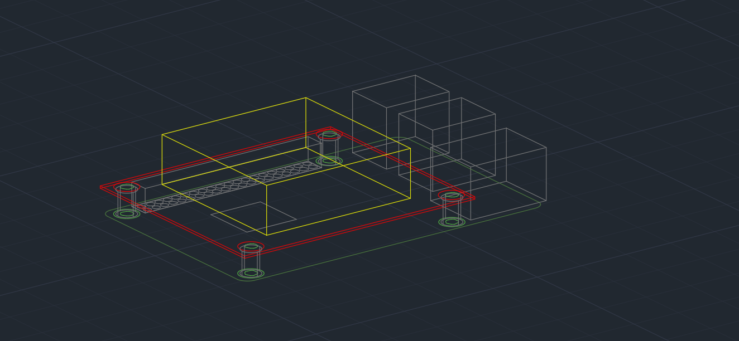
Experiment Configuration (3D CAD)
Notes:
Sam
This is a semi transparent 3d view of our experiment config, showing what it would look like mounted on a raspberry pi

Slide 17
Concept of Operations
Powers on (crontab).
Launch startup.sh, which launches all other programs in a structured order.
Turn on SPS30 and related programs; ensure data flow.
Phase 1
Continuous operation with a 12 hour (on) 2 minute (off) cycle.
Verifies continuous program functionality with a monitor program.
Sends data until 14 days before AR2B end-of-life cycle.
Phase 2
Before AR2B end date, send last packet and poweroff.
Analyze results
Write a report outlining findings.
Phase 3
Notes:
Max
Our concept of operations is divided into three different phases, based off of what our sensor will be doing. Our first phase, phase one, is where we power up all the programs we need with a crontab that launches a shell script entitled startup.sh. Our second phase, phase 2, is where we operate within an on off cycle of 12 hours to one minute, during which we send data to the AR2B data handling system, and ensure correct function with a monitoring program. Our last phase, phase 3, is where, 14 days before the AR2B end of life period, we will send a final packet and poweroff. Once all the data is received, we will analyze the findings in a report of some sort.

Slide 18
Program Overview
Status: Waiting on PCB to arrive
Completed:
All programming and functional testing
PCB design
Issues:
Timing was difficult, we received our sensor ~1 week ago.
Next:
Completing Environmental Testing
Notes:
Max
With our programming we are currently waiting for the PCB to test the sensor with our full experiment configuration. The sensor programming and functional testing is done, and the PCB design is completed as shown in the experiment config. We had a little bit of a time crunch due to when our sensor arrived, so we heavily concentrated on the sensor programming. What's up next is that as we receive the PCB, Our environmental testing will need to be done, along

Slide 19
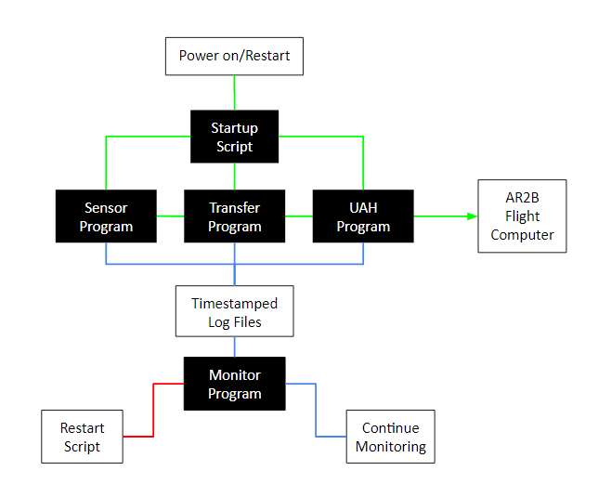
Program Overview (Flowchart)
Shown is a flowchart of our program operation.
The green line represents the data cycle
The red line represents a triggered restart
The blue line represents a log cycle
Notes:
Ben
Pictured here is a flowchart of our program operation. In this flowchart, we use green lines to represent the data cycle of our program, the red lines to represent a triggered restart, and the blue lines represent our log cycle. Next Slide Please

Slide 20
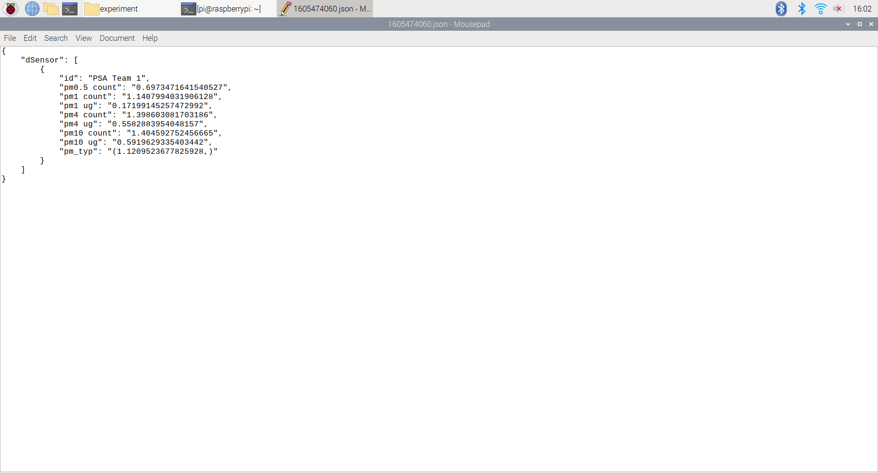
Data Packet
JSON Packet
Shown is an example of a JSON packet
Approximately 500 bytes each
Total data rate of ≤ 0.5 kBps
Shows particle concentrations and size
Notes:
Max
This is an example of what our data packets will look like. These packets are about 500 bytes each, and we have a maximum data rate of about half a kb a second. The data packet contains the particle concentration in microgram per cubic meter, and also shows the amount of particles at given sizes.

Slide 21
Testing
Notes:
Emann - We will now present our testing plan.
Next Slide please

Slide 22
Testable Requirements
Functional Requirements
Take Measurements
Organise Data Packets
Send Data
Establish Accurate Particulate Count
Handle Program Errors
Resume Operation After Reboot
Environmental Requirements
Take Measurements
Survive Hot Environment
Survive Cold Environment
Survive Extreme Pressures
Survive Random Vibrations
Maintain Structural Integrity
Notes:
Emann -
For the mission, our payload must survive certain functional and environmental requirements while on board the International Space Station.
Our functional requirements includes to be able to take measurements, organize data packets, establish an accurate particulate count, handle program errors and to be able to resume operation after reboot.
Our environmental requirements include taking measurements, collecting and sending data in temperature ranges of -20 degrees celsius to 90 degrees celsius, collecting and sending data inside a vacuum, and to remain functional after experiencing up to 4g of random vibration. In addition the payload must maintain structural integrity while experiencing these environmental conditions.
Next Slide

Slide 23
Functional Test Plan
Functional Test | Requirement | Status | Comments
Sensor Test | Take measurements; Establish an accurate particle count | Completed; Passed | Able to determine particle count, values are accurate and consistent.
Transfer Test | Organise Data Packets; Send Data | Completed; Passed | Data rate can be adjusted by changing measurement frequency.
Recovery Test | Handle Program Errors; Resume operation after reboot | Completed; Passed | Verify that the programs can handle power loss, errors, and other unpredictable exceptions.
Notes:
Emann-
To meet these requirements a functional test plan was made to meet our standards. Our first test, the sensor test, was made to determine if the payload can take measurements, and establish an accurate particle count within a margin of error.
The Transfer Test was made to determine if the payload can organize data packets and send data. The data rate can be adjusted by changing the measurement frequency to better organize and send the data.
Lastly we have the recovery test, this determines if the payload can handle program errors resume operation after a reboot. This test was simply made to verify if the program can handle power loss, errors and other unpredictable exceptions.
Finally as shown in the chart, all the tests have been performed and the payload passed each of the functional tests.
Next Slide Please

Slide 24
Environmental Test Plan
Functional Test | Requirement | Materials | Test Date | Status | Comments
Heat Test | Take Measurements, Survive Hot Environment | UAH Provided Toaster Oven and Thermocouple | Jan. 11th | Scheduled | Monitor closely.
Cooling Test | Take Measurements, Survive Cold Environment | Freezer and UAH Provided Thermocouple | Jan. 12th | Scheduled | Moisture controlled.
Vacuum Test | Take Measurements, Maintain Structural Integrity, Survive Extreme Pressures | UAH Provided Vacuum Chamber | Jan 13th | Scheduled | Check hardware before test.
Rumble Test | Take Measurements, Maintain Structural Integrity, Survive Random Vibrations | UAH Provided Accelerometer | Jan 14th | Scheduled | Check hardware before test.
Notes:
Emann-
An environmental test plan was made to simulate and determine if our payload would remain functional during out mission.
Our first test is the heat test, testing whether our payload can take measurements in temperatures up to 90 degrees celsius for an extended period of time. The test will a performed using a toaster oven provided by UAH to heat and measure the temperature range our payload remains functional. In which we’ll monitor closely to determine the exact range the payload remains functional.
The Cooling test will determine if our payload can take measurements in cooler temperatures, and will be tested using a freezer and a container for moisture control. The UAH provided thermocouple will be used to gauge
Next we have the Vacuum test, which will determine if the payload can take measurements, maintain structural integrity and survive extremely low pressures. The payload will also be subject to vacuum-like conditions and be done using a UAH provided vacuum chamber. Something to note i that our payload will be secured in a fixed location during the Vacuum test. Something to note that the hardware will be check prior testing.
Afterwards we have the Rumble Test, a test made to determine if our payload could take measurements, maintain structural integrity, and survive random vibrations. UAH will be providing an accelerometer for the rumble test and like the Vacuum test, the hardware well be checked prior to testing. accelerometer
Lastly these test have been scheduled for January.
Next Slide Please

Slide 25
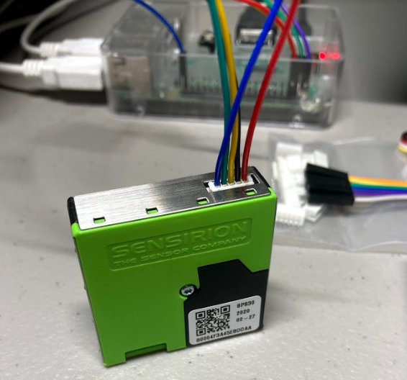
Sensor Test
Test Overview
Demonstrates that the sensor is accurate and functional.
Connected via 5 pin cable directly to GPIO header
Determines that the sensor can establish an accurate particle count
Placed in a well ventilated room
Particulate count was steady, and output matched expected results.
Results
Pass
The programs all worked as expected, data was collected with no errors
No errors with I²C connection
Data was accurate
Everything functioned as expected
Evidence
Notes:
Emann:
Test Reasoning:
The Sensor test was designed to determine if the sensors were accurate and functional and would establish accurate particulate counts. We tested this by placing the sensor in a well ventilated area, as well monitoring the particulate counts. Our payload passed this test, as the particle count remained steady over time, and no errors were encountered.
Evidence:
Shown below is the sensor alongside the data collected after the test was performed. The evidence was collected by disabling the UAH transfer program as it deletes the sent data packets.
Results:
The pi worked as expected and collected data accurately without any errors.
Next Slide Please

Slide 26
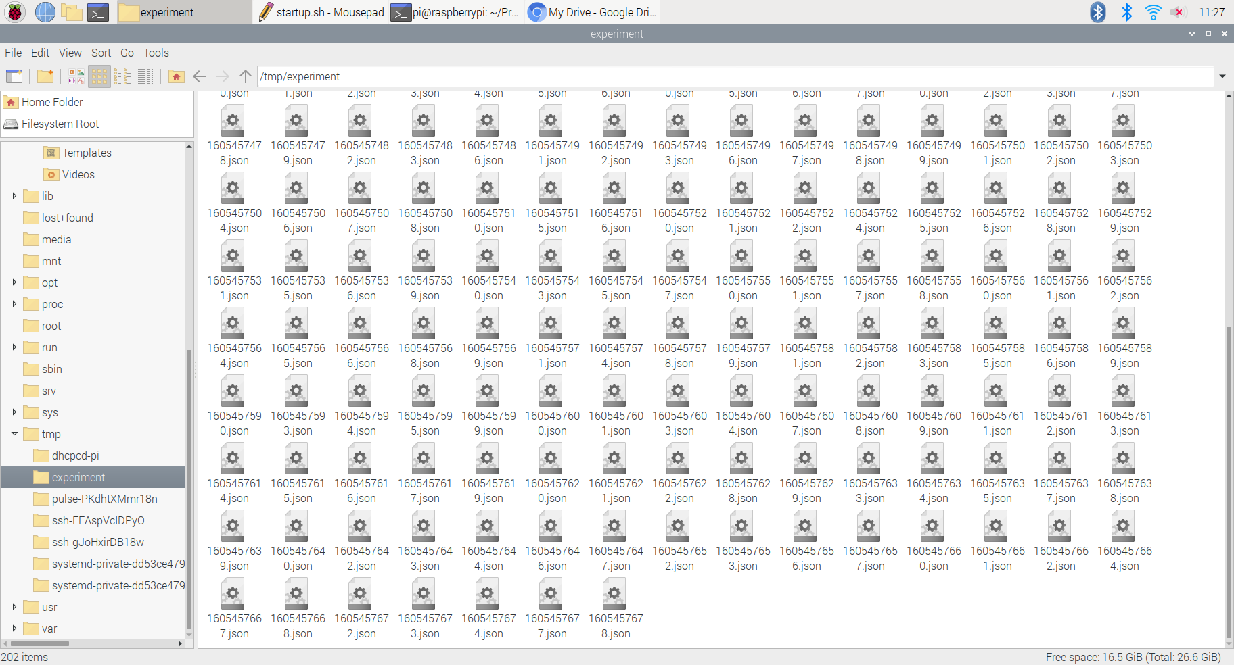
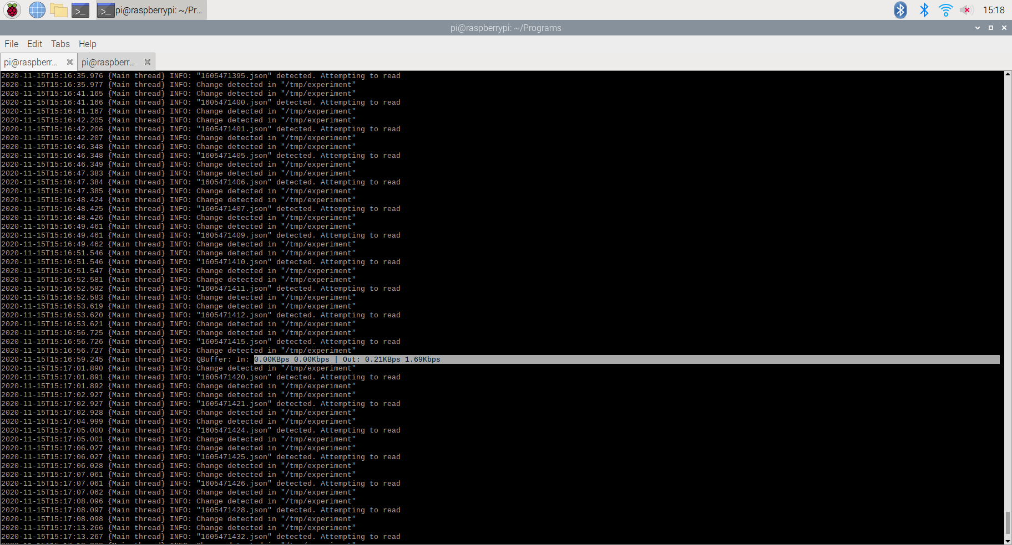
Transfer Test
Test Overview
Demonstrates that program can organize data packets, and send data via the UAH transfer program
Utilized both UAH’s and our own transfer program.
Tested that the json data collected from the SPS30 could be transferred to /tmp/experiment and collected by UAH’s data handling program
Test completed 25 times, 0 failures
Pi was rebooted via various physical/software stimuli (see Recovery test)
Results
Pass
The programs all worked as expected, data was transferred in time stamped files to /tmp/experiment
Max of 0.5 kBps, average of 0.3 kBps
Example from UAH transfer program:
Evidence
A picture of the populated /tmp/experiment folder after a run with the UAH program disabled.
Notes:
Emann:
Tesy Reasoning:
The purpose of this test is to ensure that we can both format JSON files correctly and send those files to the correct place under the maximum data rate. We tested this by utilizing the Data sending file provided to us by UAH. Our program passed this test, as we both successfully populated the /tmp/experiment folder with JSONs, and also remained well under the 5 kbps data rate.
Evidence:
Currently shown in the bottom right is the tmp experiment folder after a run with the UAH program disabled. This was done to collect the data from the test as the program deletes the files after sending them to UAH.
Results:
The payload passed the test and worked as expected, transferring the time-stamped data files into the tp experiment folder as expected. The pi had a max of 0.5 kbps and an average of 0.3 kBps. Shown in the bottom left is an output of 0.21kBps from the UAH transfer program when enabled.
Next Slide Please

Slide 27
Recovery Test
Test Overview
Demonstrate that program can remain functional after handling hardware/software errors and resume operation at reboot.
Errors tested: Unplugging SPS30 GPIO wires, cutting power, killing programs, restart, shutdown
All restarts are executed by a monitor program
Wires were plugged back in and power was restored after 10 seconds of being disconnected for this test.
Results
Pass
The programs all worked as expected, always started back up after reboot.
The monitor program was able to detect and recover from all conceived errors.
Note: UAH transfer program disabled after successful relaunch to get evidence.
Evidence
Notes:
Emann:
Test Reasoning:
The Recovery test was designed to determine whether the program can remain functional after handling program errors and resume operation after reboot.
Evidence:
As shown below, the payload was able to perform a reboot after encountering a handling error and perform a reboot before resuming operation. Currently shown is a picture of the data packets collected in the tmp/experiment demonstrating that the program ran normally and remained consistent with data before being tested. The Recovery test was run over a 50 of times and in many different manners such as cutting power or killing programs.
Results:
The payload worked as expected after reboot passing the recovery test. The monitor program, a program to identify errors , was able to successfully detect and recover from all conceived errors. Something to note was that the UAH transfer program was disabled after successful relaunch to obtain the evidence.
Next Slide Please

Slide 28
Online Outreach Platform
Notes:
Morgan - And now we will present our Online Outreach Platform
Next Slide Please

Slide 29
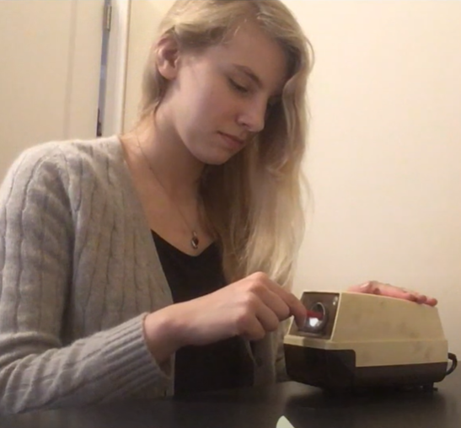
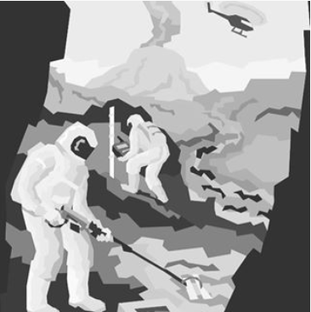
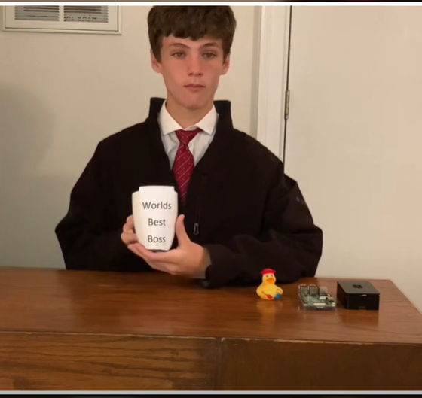
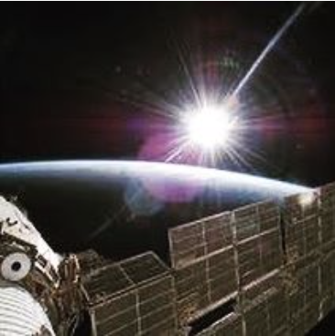

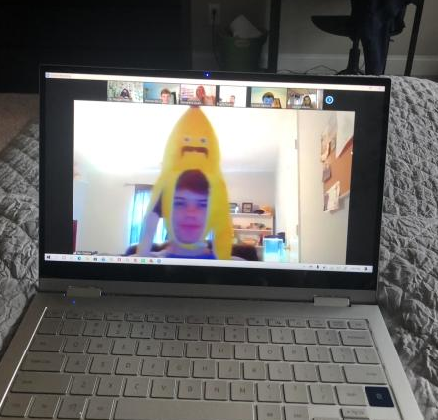
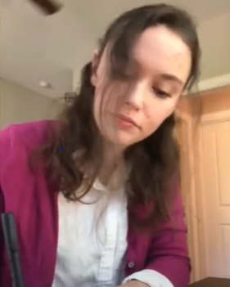
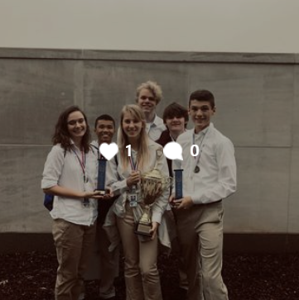
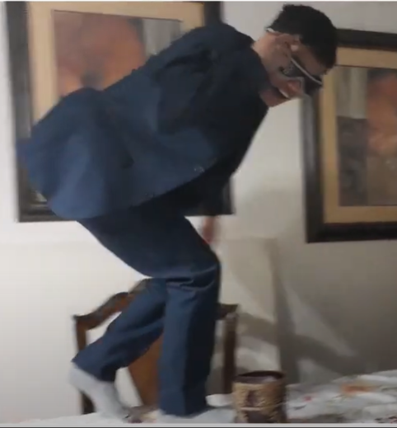

Outreach Content
We have created an online platform through a Website, Instagram, and Youtube.
Our goal is to create an online presence to engage and inform viewers by sharing interesting posts and activities. We will also be sharing surveys and creating a data analysis based off what we learn not only from out data, but the experience of running a outreach project entirely online and having fun in the process.
Notes:
Morgan
Outreach will create and run an online forum through multiple social media platforms.
The website is our main hub. Ever Friday, on the website, an update of any new videos or other released content is posted.
We have an Instagram which is updated on Monday, Wednesday, Friday.
Monday we have activity posts which are in either Photo + Instruction or short video form.
Wednesday our posts are either fun fact posts or a style of post we call “Pioneers in Space” where we have an info post about someone who was a trailblazer in the STEM field.
Fridays our posts are the same as the website, a notification for already out or upcoming youtube videos as an example.
Most newly added is our Youtube!
The plan is to spend at least an hour on Sundays dedicated to planning out the next weeks, and any other upcoming videos.
Wednesdays will be filming days since we have that as an allotted work day at our school.
Videos will be uploaded and published on Saturdays.
We’ll go over our planned videos in a later slide.
Accumulatively at PSA we have collected 650 surveys
The screen shots on the slide are a combination of photos from our instagram page and screen shots of clips from our youtube channel which we created as a parody to the office opening.
NEXT SLIDE PLEASE

Slide 30
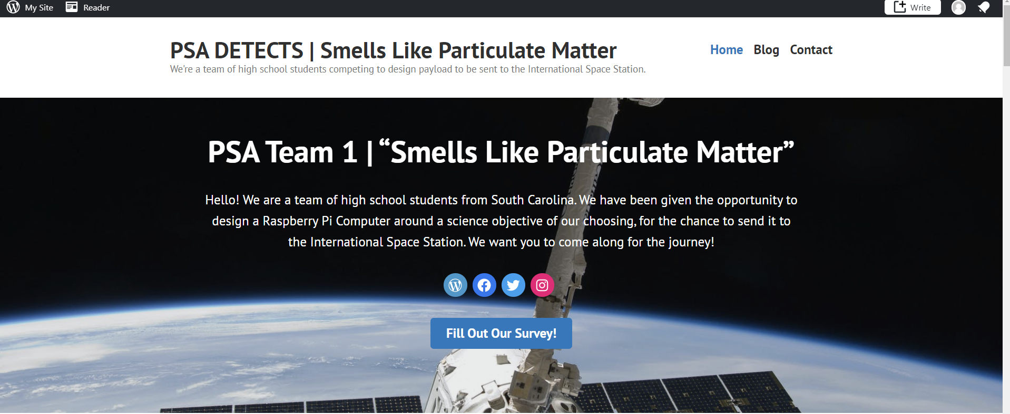
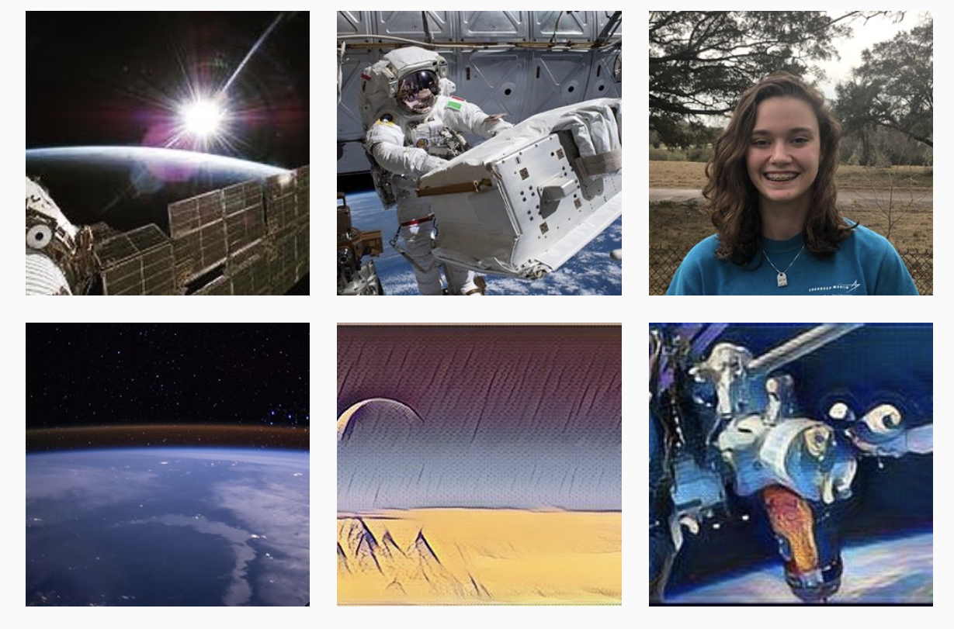
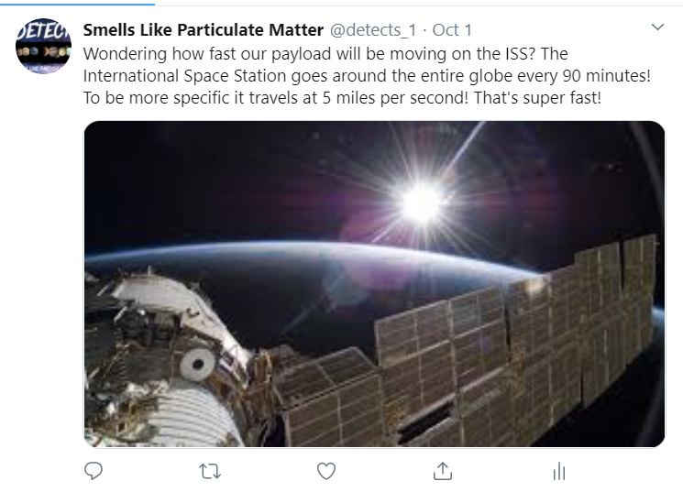
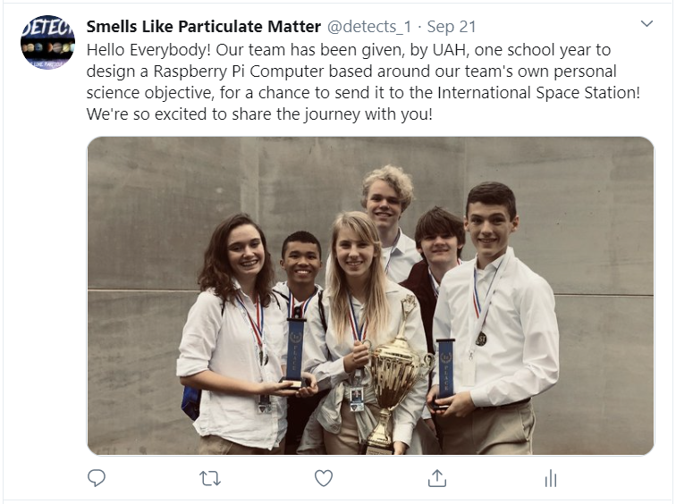
Platform Screenshots
Notes:
Morgan
Here are some screenshots of our platforms.
On the top we have our website, the bottom left our twitter, in the center photos from our instagram, and then another of our twitter. NEXT SLIDE PLEASE

Slide 31
Planned Video Activities
Because our science objective is so specific, we want to engage our audience through more general topics in our activities
How sensors work: an info. video
Building a Model Solar System
The phases of the moon
Building a Timeline of Space Firsts
Once we build a more substantial following, we plan on asking our followers what they want to learn more about and want to see next
Notes:
Morgan
We have a very specific science objective, therefore we have decided to have all of our virtual activities be based on more general concepts and topics. This is also of benefit to the team as we have a larger playing field when it comes to finding ideas for activities and we can make our activities more compatible with more viewers no matter the age or grade.
Our ideas include a video discussing and showing examples of what sensors are and how they work.
We want to do a project video on building a model solar system, and also one with the phases of the moon.
We also want to do a video that goes over and shows us building an interactive and engaging timeline of Space Firsts.
We have multiple videos in the editing stage at the moment.
Once we develop more of a following we want to start doing polls and surveys to ask what kind of content people want to see if that be learning more about our team or activities they want us to try. I’m also currently working on mapping out videos ideas that will be posted in addition to our activity videos in order to busild a stronger base for our channel to grow and accumulate more followers.
NEXT SLIDE PLEASE

Slide 32
Survey Data

Slide 33
Design Phase Summary
Notes:
Morgan - And now we will present our Design Phase Summary slides
Next Slide Please

Slide 34
Lessons Learned
Leadership | Programming Group | Testing Group | Outreach Group
We learned better methods to work on a compacted timeline, and as a result we believe that our ability to balance workloads improved significantly. | We learned how to work with each other using online communication methods in order to remain productive and complete the program. | We learned the importance of communication while completing testing, especially in a virtual environment. | We learned how to operate online media platforms in order to collect information and tell people about our project.
Communicating exclusively over the internet led to a few miscommunications near the beginning of the semester. | Having to program without the hardware in front of you introduced more challenges. | It is hard to complete testing when you cannot collaborate in person with your teammates. | Running multiple social media platform takes a new level of organization and collecting surveys is a much more difficult process.
Next semester, we plan to start using the task assignment feature more regularly. Online, it’s easier for team members to work on separate tasks in their free time and use class hours to combine and communicate. | Programming should be much easier next semester, as we will likely be back in school, and be able to program with the hardware closeby. | Next semester, we plan on scheduling team testing deadlines and making sure to schedule Zoom calls while testing is being performed. | If we were to change some of our processes, we would most likely reach out on our schools more established social media platforms, and encourage teachers to give out surveys in class.
Notes:
Michael → Max → Emann → Morgan
Michael:
During this semester, we learned how to better manage our time and balance workloads. We encountered trouble in the beginning of the semester with online communication, but we have established new methods of delegating work to remedy this problem. This new method is basically creating a large and detailed list of tasks, and assigning a due date rather than having to struggle with working all at once while on Zoom.
Max:
Overall with programming we’ve learned how to work on programming online.
The biggest difficulty with this is programming without the physical hardware present, as it introduced new difficulties.
Next semester should be much easier with programming, as we will likely be back in person in some capacity, solving a lot of the working online issues.
Emann:
As a team we learned the importance of communication while completing the testing as scheduling became much more difficult in a virtual environment.
Certain opportunities and testing that could once be done in-person were no longer available as a result we had to find ways to work within a virtual environment.
Moving forward we plan to schedule team testing deadlines and scheduling Zoom calls while testing is being performed.
Morgan:
With having to manage what we now call outreach on an entirely online platform for the first time, some challenges have popped up.
Going from 0 to 100 in managing multiple platforms, especially as a student, has challenged our time management an organization skills.
We’re also noticing that gaining a following is a slow and challenging process. It’s a challenge, and as we’re noticing even more that it’s even more difficult as a STEM focused platform. Survey collection is also a challenge.
Without being able to be right in front of people asking for their time to fill our the survey, we have to find a way to be more creative way to persuade people to take the time to fill out our survey.
We’ve worked around these issues by working with other teams on survey collection and figuring out ways to get our surveys out creatively
We’ve reached out to larger platforms and are waiting for a response, and we’ve also utilized our parents platforms to spread the survey

Slide 35
Summary
Design Summary | Science Objectives: Assess particulate density, prevalence, size, and levels over time Compare to currently used particulate sensing equipment Configuration Instruments: SPS30 Particulate Matter Sensor PCB is 65 x 56.5 x 0.8mm 65 x 56.5 x 17.8mm Outputs ~0.3 kBps normally, max 0.5 kBps 6 Major Program Parts Startup, Control, Transfer, Monitor, UAH’s Data Send, and Restart
Initial Testing | Testing Passed Initial Functional: Sensor - ±10μm/m³ (±3μm/m³ in testing) Transfer - Max data rate of 0.5kBps Recovery - Payload recovered from all conceived scenarios
Notes:
In summary, our objective is to measure particulate density, prevalence, size, and levels over time while onboard AR2B and compare the generated data with expected results and other particulate sensing equipment. We will be using an SPS30 mounted on a raspberry pi hat, with a total size of 65 by 56.5 by 17.8 mm. To operate this hat, we have 6 main programs that all work in conjunction to ensure proper functionality.
All of our functional testing was completed without issue, and we were able to confirm the factory guaranteed accuracy of plus or minus ten micrograms per meter cubed, and we actually got much more accurate measurements with an accuracy of plus or minus three micrograms per meter cubed. During the transfer test, we recorded a maximum data rate of 0.5 kilobytes per second with an average data rate of 0.3 kilobytes per second. During the recovery test, the payload was able to recover from all conceived scenarios. Thank you for listening to our presentation.

